Slide 1
Website design on Hospital
This is just a outlier of website.

Slide 2


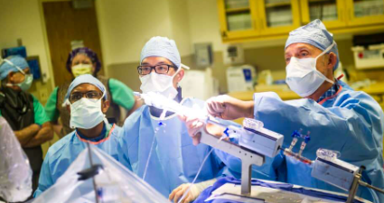

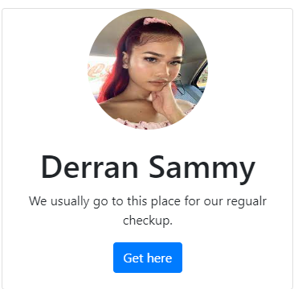



Home page
Max Healthcare
Home
Contact
Login
We ask more of ourselves, so we can give more to our patients.
Connect with us on contact page.
© Max healthcare

Slide 3
About Home page
There is a nav bar at the top where the following items are there:
Logo of the hospital
Name of the hospital
Button1 – Home Page
Button2 – Contact page
Button3 – Login
There is a Heading just below the nav bar bar which shows the main motto of the hospital.

Slide 4
About the home page
There are two divisions just below the headings. These two division contains the two images from hospital. The first one is the doctor with surgery and the second one is the image of the hospital.
Just below the images there are three cards where we put people feedback which attracts the other patients.

Slide 5
About the home page
Just below the cards, there is a footer section where we will keep the address of the hospital at different location in address tag.
The card will look like below:
His saying in H3 tag
Image of the patient

Slide 6




Contact Us page
Nav bar
Max Healthcare
Title and logo of the hospital here
Home
Home
Contact
Contact
Login
Login
Contact us on the below address
Fill this form to get in touch with us.
Bindusar Bujurg, Bihar 841226
Sewa Max Care Hospital, address
Enter name here
Enter complete address
Connect on social media apps
Brief description of the problem
Mobile number
maxgniotsuperhospital@nic.in
Submit the request

Slide 7
About the contact page
The nav bar is same as the home page.
Below the nav bar there are two sections of the page.
The first section contains the address of the Hospital in p tag.
The second section contains the form which should be filled for an appointment.
There is a button at the end of the form.

Slide 8
About contact page
Below the address paragraph, there is a section where we can put the social icons like facebook, instagram, etc.

Slide 9
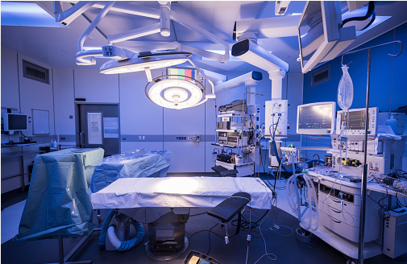

Max Healthcare
Home
Contact
Login
OUR FACILITIES
Operating rooms are designed for surgeons and surgical staff to perform surgical operations that require time, patience, focus, and safety. Various pieces of equipment are required for use in the operating room.
Science Research & Technology
Health & Pharmacy
Biology Laboratory & Medical Research
Connect with us on contact page.
© Max healthcare

Slide 10
About facilities page
There is a same nav bar at the top.
Below this there is a heading called as our facilities.
There are two image and text combination for the website.
At last we have the footer of the page.

